Slide 1
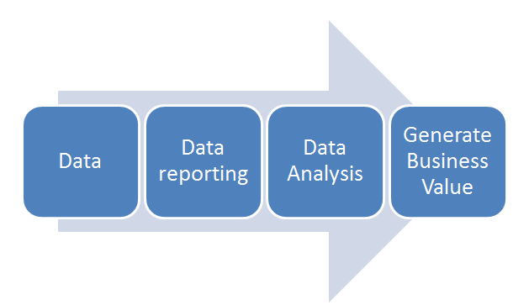
Data Analysis
.

Slide 2
Need ?
Product across Location
Country Wise Food
Managing
Resturent
Need

Slide 3
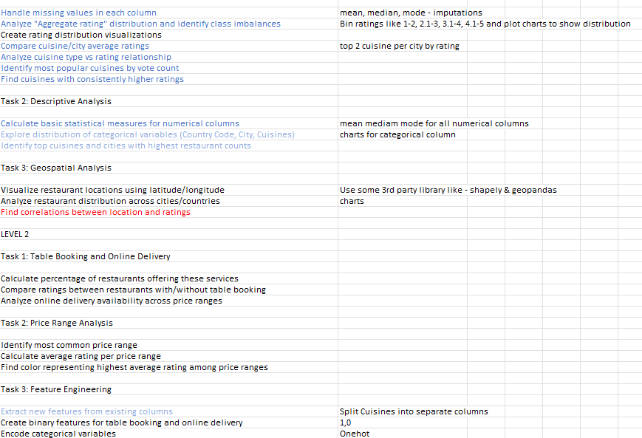

Slide 4
Objectives
Analyze restaurant data using pivot chart and pivot tables
Tech used: Excel ,data analysis tool
Key Learning: Data handling,visualization,business insight
Data cleaning and preprocessing

Slide 5
Data Exploration and Preprocessing
Result:
Task :1

Slide 6
Analyze "Aggregate rating" distribution and identify class imbalances
There are many ratings in the 0-1 and 3-4 ranges, and fewer in the 1-2 and 4-5 ranges, showing uneven distribution.

Slide 7
Rating distribution visualizations
The average ratings across all cities are consistently high, with no significant class imbalance or outliers present.

Slide 8
Compare cuisine/city average ratings
Cuisine/City average Rating
Highest-rated (4.9):
Sunda, Jakarta, Tangerang, European, Hyderabad, Inner City, Pasay City, Tampa Bay, Auckland, Pretoria, Coimbatore, Cedar Rapids/Iowa City, Doha, London
Moderately-rated (4.5 - 4.75):
London, Seafood, Taguig City, Continental, Dubai, Johannesburg, Cajun, Orlando, Sushi, Scottish, Sandwich, Mexican, Asian, Abu Dhabi, Vietnamese
Lower-rated (Below 4.0):
Assam, North Eastern, Bihari, Oriya, Bengali, Raw Meats, Tibetan, Drinks Only, Nepalese, Awadhi, Afghani, Gurgaon

Slide 9
Analyze cuisine type vs rating relationship
Conclude
North Indian with 2992 ratings
Chinese with 856 ratings
Fast Food with 672 ratings
Bakery with 622 ratings
Cafe with 617 ratings

Slide 10
Most popular cuisines by vote count
Conclude
North Indian cuisine is the most Popular
Vote:
2992

Slide 11
Cuisines with consistently higher ratings

Slide 12
Task 2: Descriptive Analysis
.

Slide 13
Calculation basic statistical measures for numerical columns
Longitude
Mean | 64.12657446
Standard Error | 0.424305636
Median | 77.1919642
Mode | 0
Standard Deviation | 41.46705785
Sample Variance | 1719.516887
Kurtosis | 8.216586264
Skewness | -2.807327834
Range | 332.7805753
Minimum | -157.948486
Maximum | 174.8320893
Sum | 612472.9127
Count | 9551
Latitude
Mean | 25.8543807
Standard Error | 0.112637094
Median | 28.57046888
Mode | 0
Standard Deviation | 11.00793512
Sample Variance | 121.1746357
Kurtosis | 12.53080267
Skewness | -3.081635351
Range | 97.307408
Minimum | -41.330428
Maximum | 55.97698
Sum | 246935.1901
Count | 9551

Slide 14
Calculation basic statistical measures for numerical columns
Votes
Mean | 156.9097477
Standard Error | 4.401643186
Median | 31
Mode | 0
Standard Deviation | 430.1691454
Sample Variance | 185045.4936
Kurtosis | 128.2259689
Skewness | 8.807636688
Range | 10934
Minimum | 0
Maximum | 10934
Sum | 1498645
Count | 9551
Average Aggrigate rating
Mean | 2.666370014
Standard Error | 0.015516113
Median | 3.2
Mode | 0
Standard Deviation | 1.51637754
Sample Variance | 2.299400843
Kurtosis | -0.582217137
Skewness | -0.954130473
Range | 4.9
Minimum | 0
Maximum | 4.9
Sum | 25466.5
Count | 9551

Slide 15
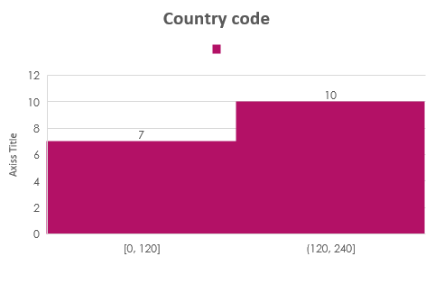
Explore distribution of categorical variables (Country Code, City, Cuisines)

Slide 16
Top cuisines and cities with highest 3 restaurant counts
North Indian cuisine dominates multiple cities.
Especially New Delhi, Noida, and Gurgaon, with 4297 total restaurants.

Slide 17
Task 3:Geospatial Analysis
.

Slide 18
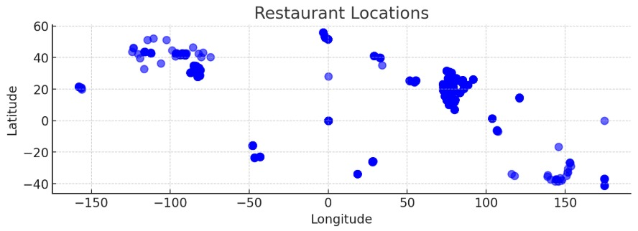
Visualize restaurant locations using latitude/longitude

Slide 19
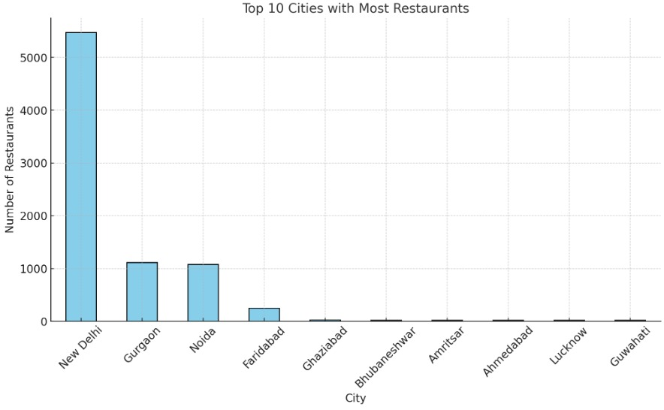
Analyze restaurant distribution across cities/countries
New Delhi
Has Highest Restaurant Count

Slide 20
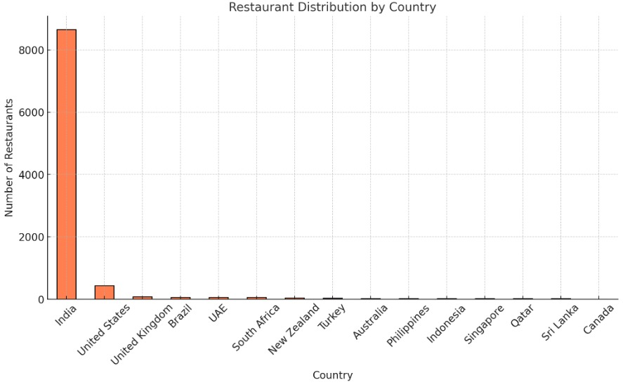
Analyze restaurant distribution across cities/countries
India Highest Restaurant Count

Slide 21
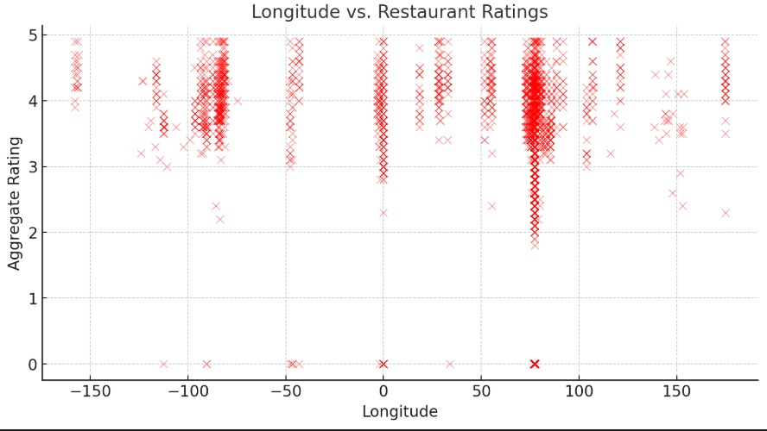
Find correlations between location and ratings

Slide 22
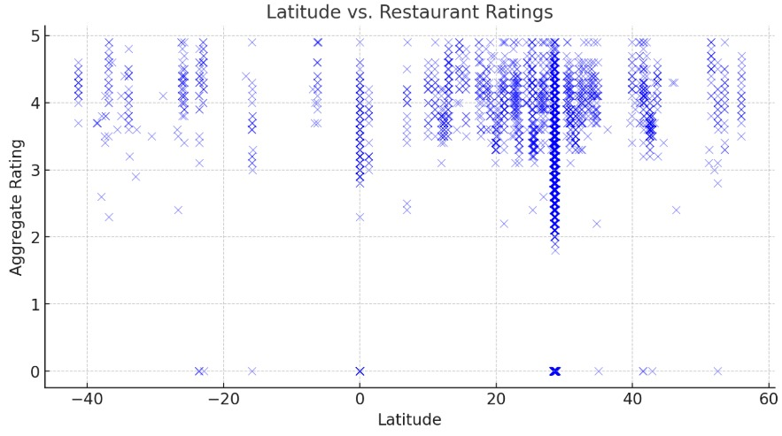
Find correlations between location and ratings

Slide 23
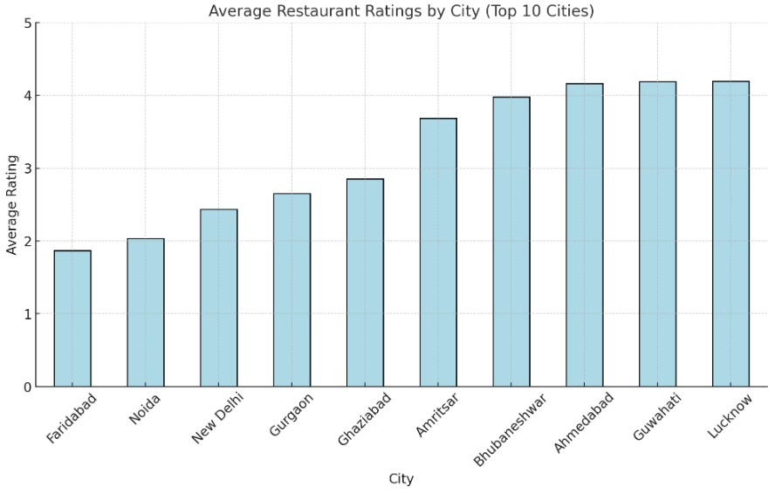
Find correlations between location and ratings
Location India:Lucknow,
Guwahati and Ahmedabad have highterst Restaurant rating

Slide 24
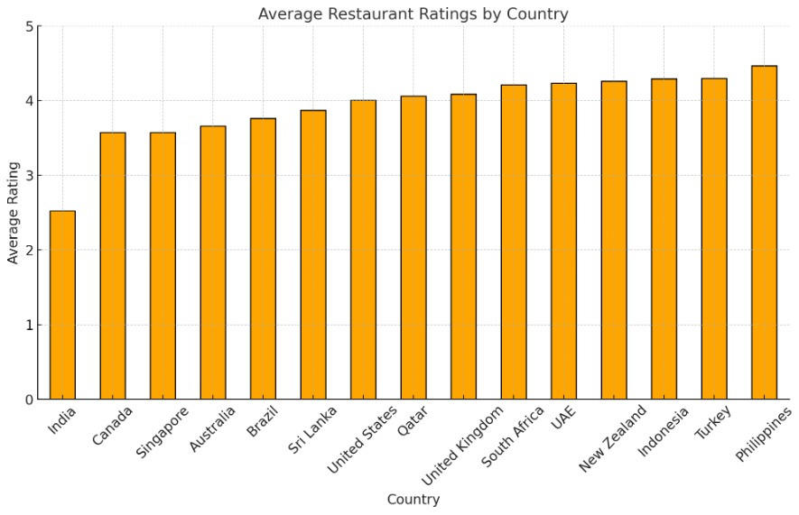
Find correlations between location and ratings

Slide 25
Task 1:Table Booking and Online Delivery
Level :2

Slide 26


Percentage of restaurants offering these services
Has Table Booking
Less Online Booking
Less Table Booking

Slide 27
Comparing ratings between restaurants with/without table booking
Table Booking Have more Rating
Less Rating for no table Booking

Slide 28
Analyzation online delivery availability across price ranges
Overall, 74.34% of restaurant bookings are made without table reservations.

Slide 29
Task 2: Price Range Analysis
Level :2

Slide 30
Most common price range
The most common price range is 1

Slide 31
Average rating per price rang
Price Range (4):Has highest average rating

Slide 32
Color representing highest average rating among price ranges
Dark Green is the color representing highest average rating

Slide 33
Technology Details, Tools, and Software Used:
Reporting and Visualization:
Utilized Conditional Formatting, Charts, and PivotCharts to visually represent data and trends.
Data Analysis:
Applied functions like SUMIF, COUNTIF, and AVERAGEIF to analyze sales trends by product category, region, and time period.
Used PivotTables for data summarization and aggregation.
Microsoft Excel was the primary tool for data cleaning, analysis, and reporting.

